Slide 1
A New Approach to Detecting Frame Deletion in H.264 Encoded Digital Video
Hunter Kippen
Advisor: Dr. Matthew Stamm
Drexel University
hmk64@drexel.edu

Slide 2
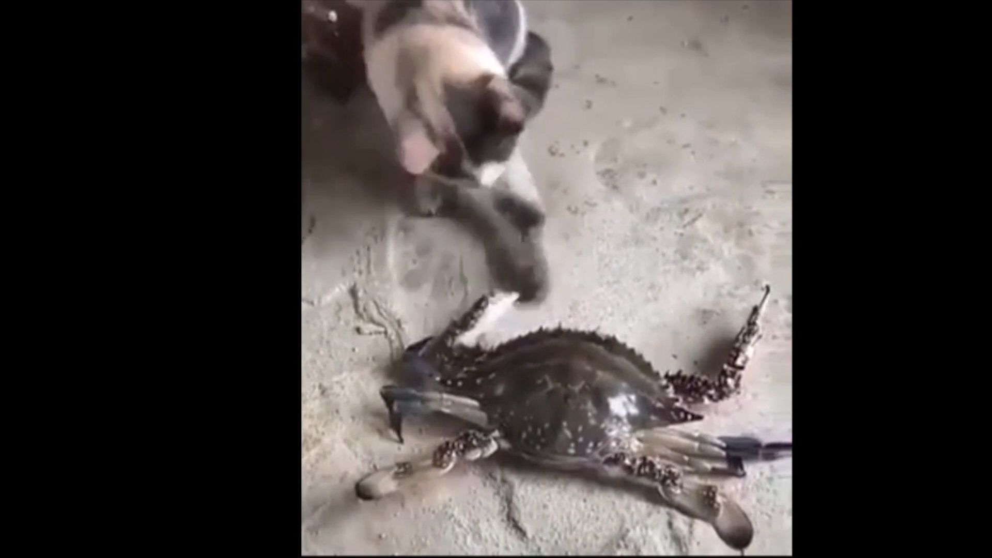

Video Tampering
Digital videos are used as evidence of events
Software can create perceptually undetectable forgeries

Slide 3
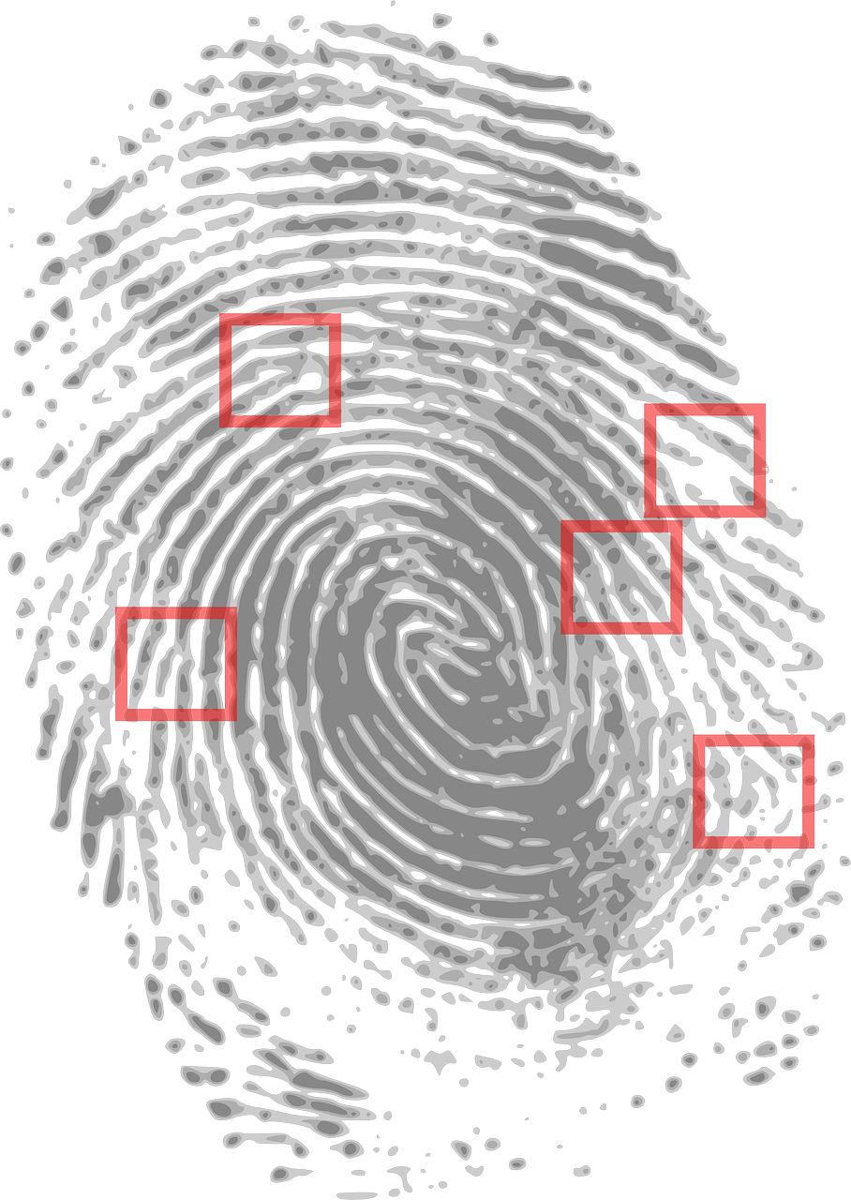
Multimedia Forensics
Forensics can provide information about authenticity when the information source is not trusted
Detect traces known as fingerprints left by processing and manipulation
Left by the capture process
Introduced by editing operations
Detecting fingerprints left by editing is known as forgery detection

Slide 4
Video Frame Deletion
Frame deletion occurs when a frame or sequence of frames are removed from a video
Potential effects include:
Removing the context
Removing the presence of objects
Often visually undetectable

Slide 5
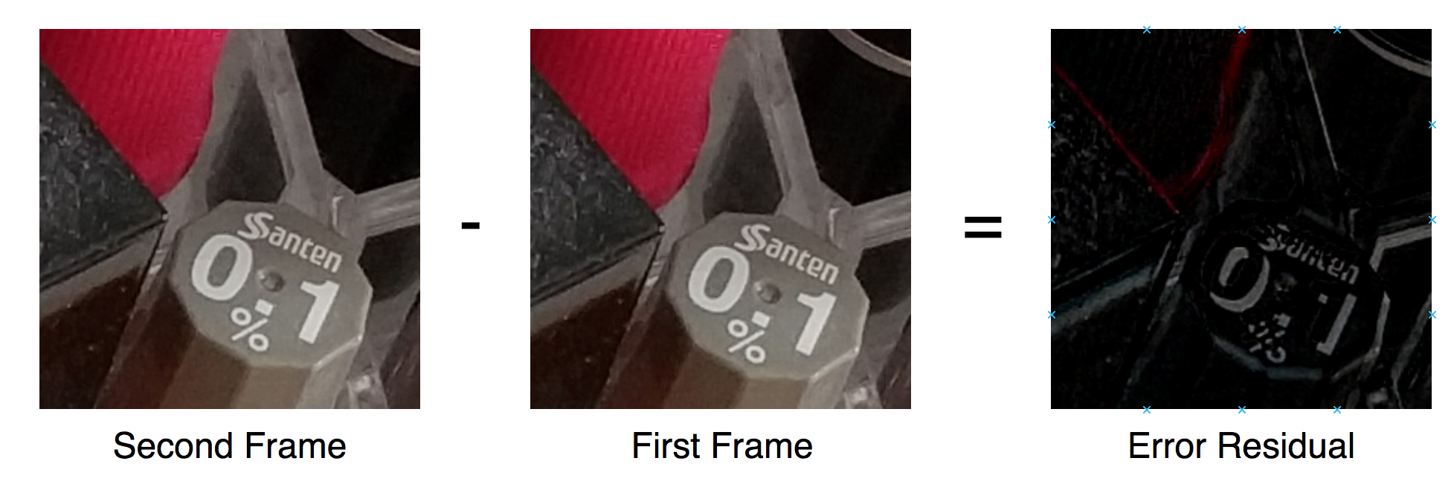
Video Compression Overview
Subsequent video frames are similar
Can predict the content of the current frame from a previous frame

Slide 6
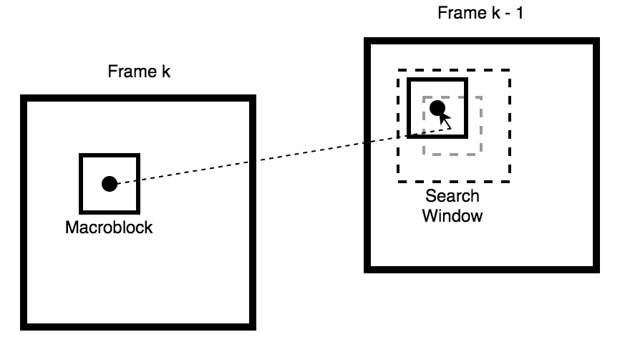
Video Compression Overview
Frames are partitioned into macroblocks
Encoder finds least error mapping into reference frame
Block Matching
X and Y displacement for mapping recorded
Encoder stores motion vectors and error residuals

Slide 7
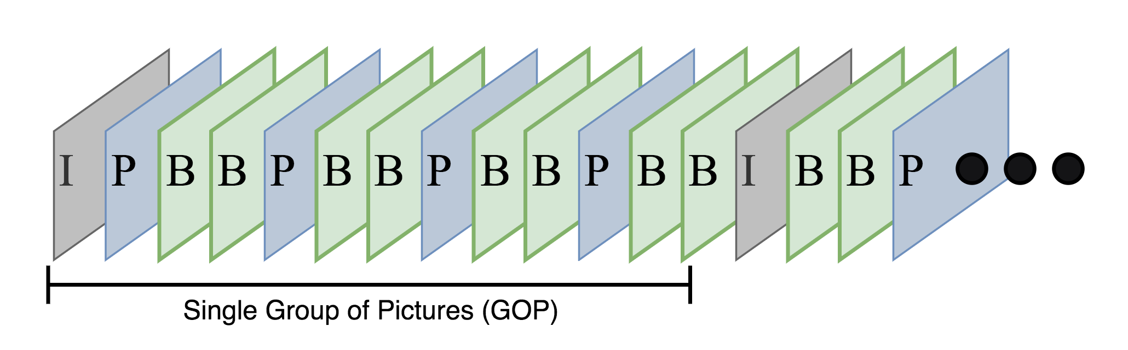
Group of Pictures
Frames are separated into Groups of Pictures (GOP)
Prediction occurs only within each GOP
Each GOP contains three frame types
Intra-frames (I-frames)
Predicted-frames (P-frames)
Bidirectional-frames (B-frames)

Slide 8
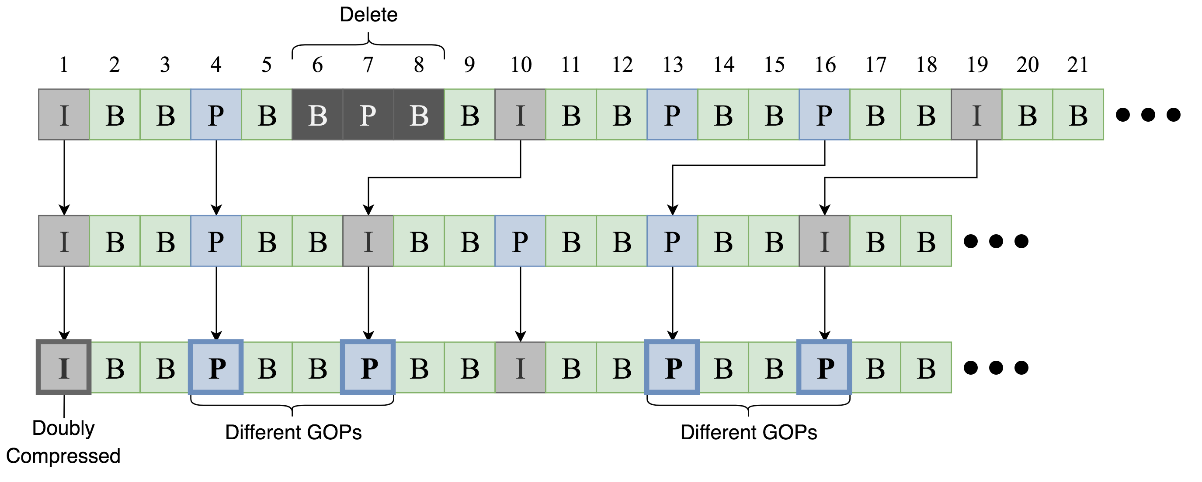
Frame Deletion Fingerprints
Frame deletion affects P-frame prediction error
Frames predicted within same GOP have less prediction error
Frames predicted across old GOPs have greater prediction error
Frame deletion and addition introduces a temporal fingerprint [Wang & Farid 2006]

Slide 9
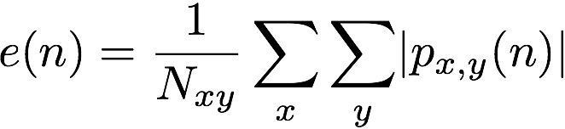
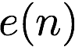
Frame Deletion Fingerprints
Define P-frame error signal as
Temporal fingerprint results in a pattern of increased values
Can visually inspect the DFT of the P-frame error signal to detect frame deletion [Wang & Farid 2006]
Visual inspection is prone to human error
Not feasible for large scale operation
P-frame index
prediction error

Slide 10
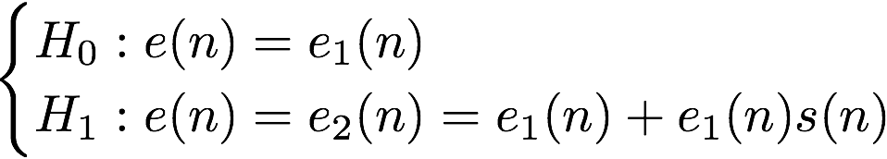
Automatic Detection
Automatic detection methods were formulated for detecting frame deletion [Stamm et al. 2012]
Model prediction error sequence for video with frame deletion
Detection formulated as a hypothesis test
Temporal fingerprint

Slide 11
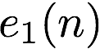
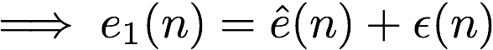
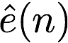
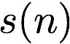
Automatic Detection
Need to extract estimate of temporal fingerprint
Process incoming to estimate
From estimate

Slide 12
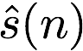
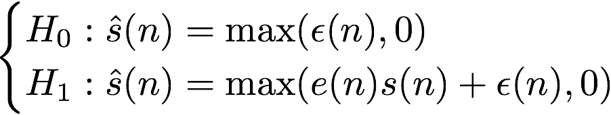
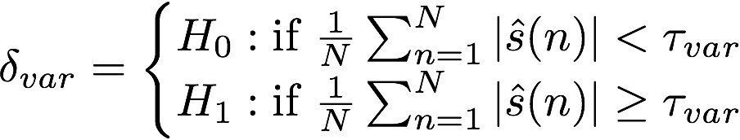
Automatic Detection
Reframe hypothesis test in terms of
Use a decision function based on the energy of [Stamm et al. 2012]

Slide 13
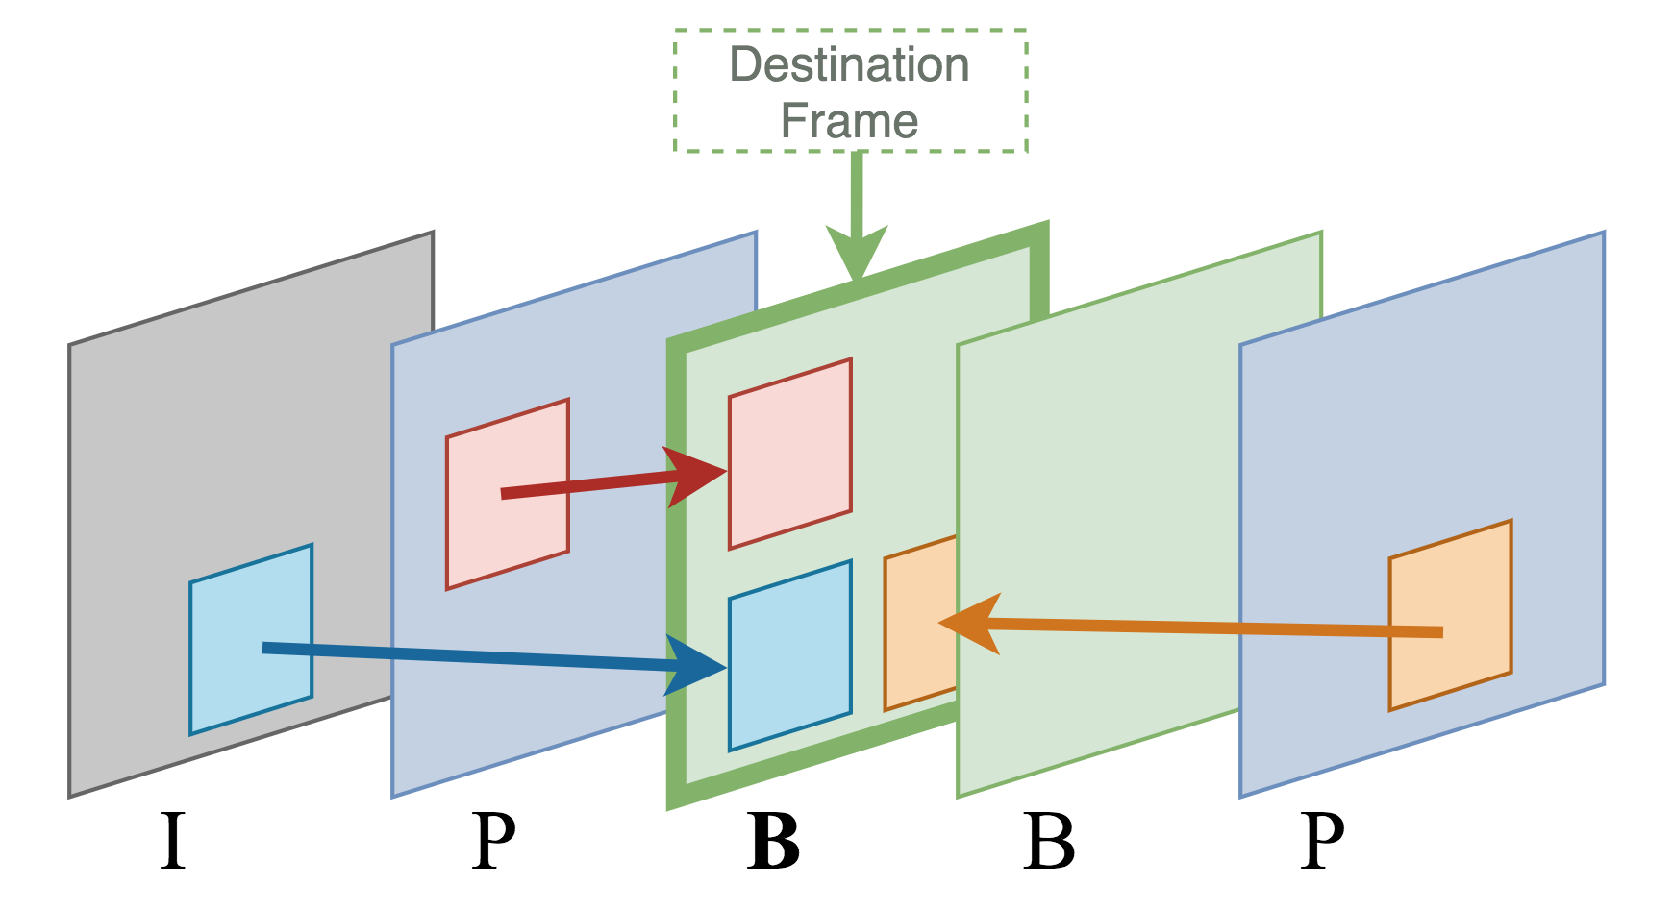
Automatic Detection
Decision function formulated for MPEG-2 video
H.264 standard updates inter-frame prediction process
It is unclear whether the frame deletion fingerprint is expressed in H.264 encoded video.

Slide 14
Preliminary Experiment
Testing detector performance on H.264 video requires a dataset
The dataset was gathered using one camera model
ASUS ZenFone 3 Laser
257 - 5 second long videos
Variety of lighting conditions (indoor & outdoor)
Variety of motion and scene content
For each video in the dataset, we
Decoded the video
Removed the first 15 frames (Half GOP)
Reencoded the video using the same encoding parameters

Slide 15
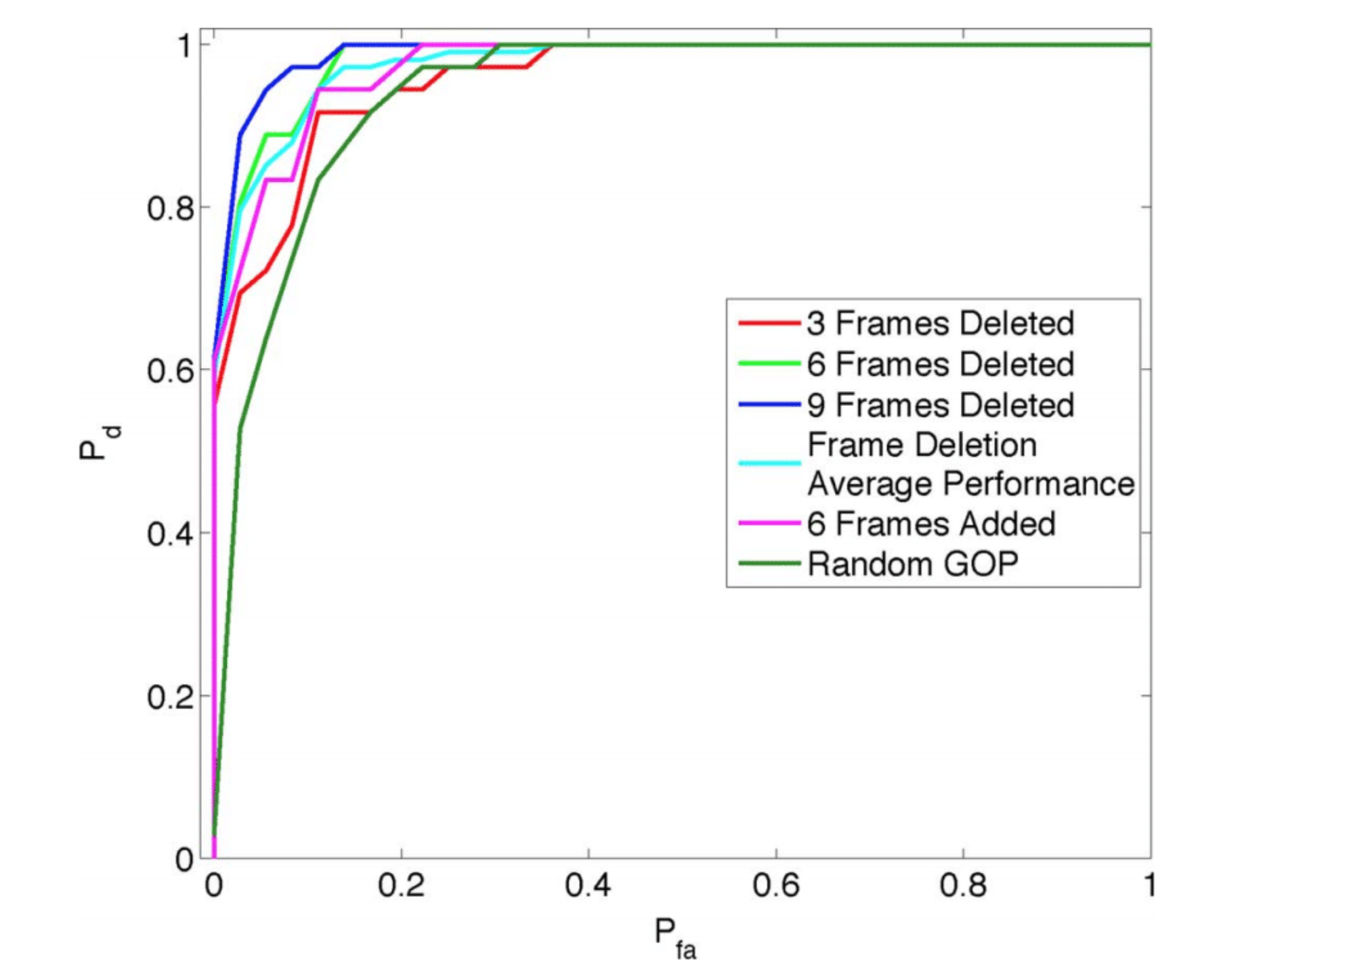
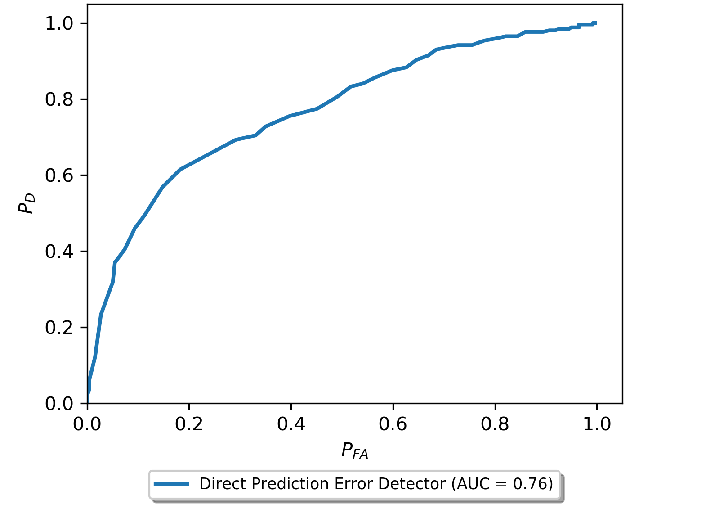
Preliminary Experiment
Fingerprint is not strongly expressed in H.264 video
We need new methods to isolate the fingerprint
*Figure reprinted with permission from Stamm et al.

Slide 16
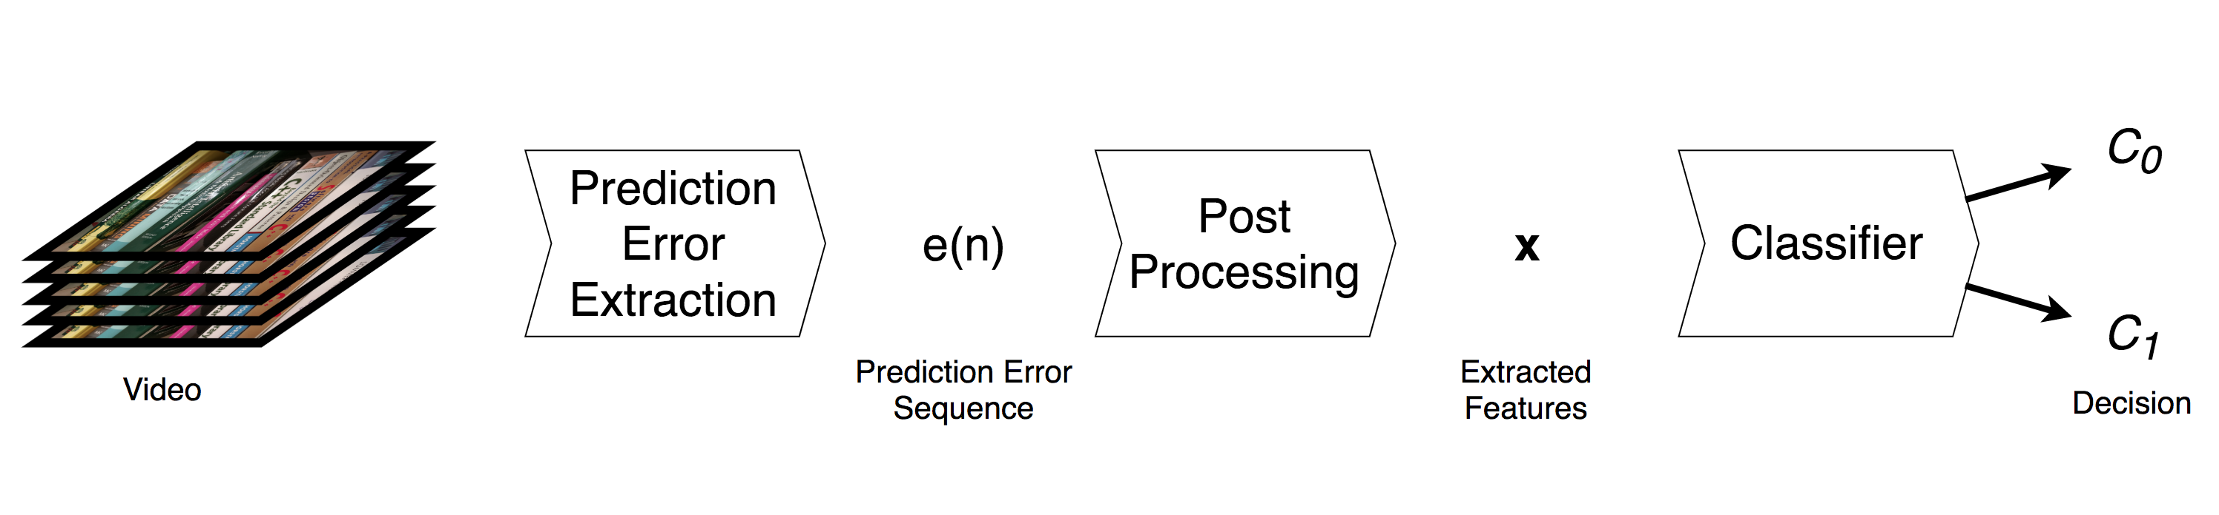
General Frame Deletion Detection Approach
Frame deletion detection can be thought of as a binary classification problem
Given a video V

Slide 17
General Frame Deletion Detection Approach
Given extracted features x

Slide 18
Assumptions
All source videos have been initially compressed using H.264 or MPEG-4
Altered video undergoes recompression using H.264 after frame deletion
GOP structure of reencoded video matches original video
Videos are of sufficient length
Frame deletion does not occur at the end of the video
The number of frames deleted is not a multiple of a full GOP

Slide 19
Assumptions
A user will not need physical access to devices
Function on videos of any
Length
Resolution
Frame rate
GOP structure
Data driven approach
Labeled Dataset required

Slide 20
Proposed Prediction Error Extraction Method

Slide 21
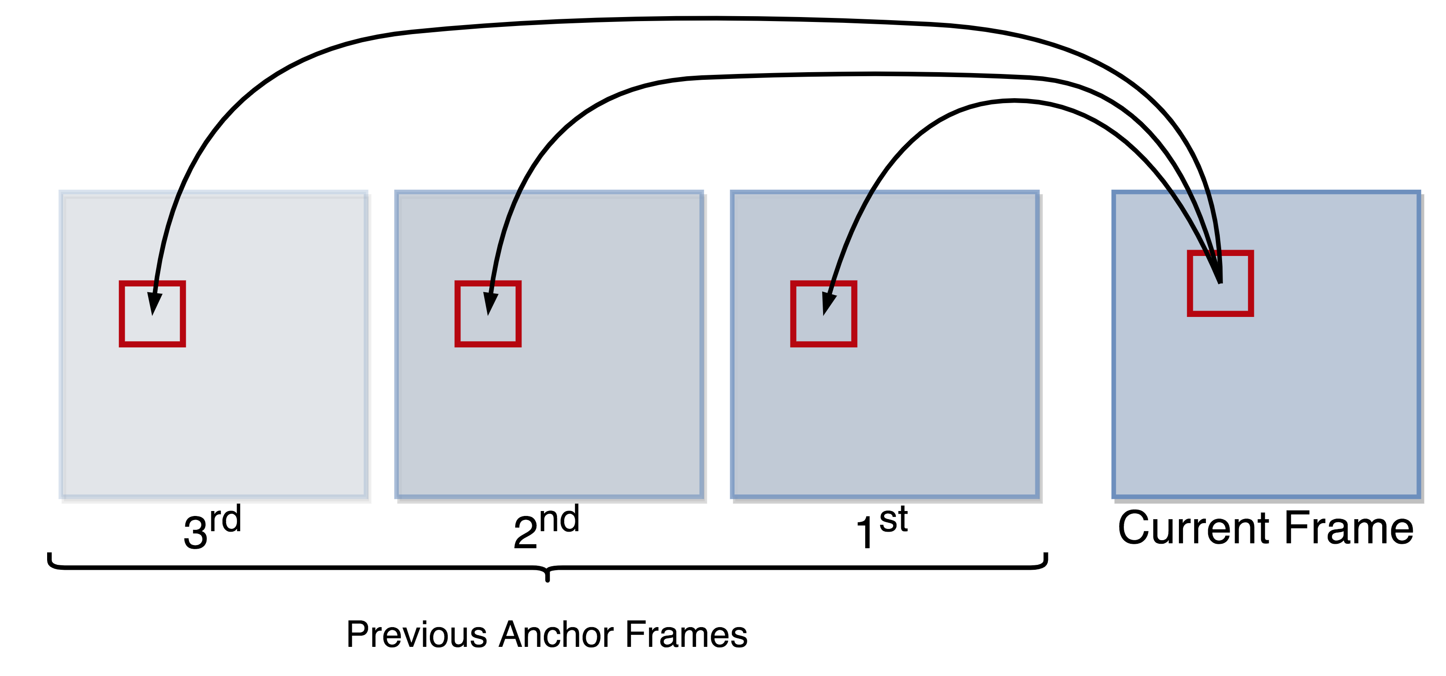
Proposed Prediction Error Extraction Method
Our proposed method should maximize the probability of observing a cross-GOP prediction
Instead of directly observing P-frame prediction error

Slide 22
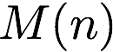
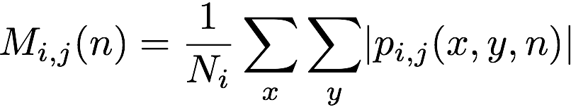
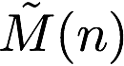
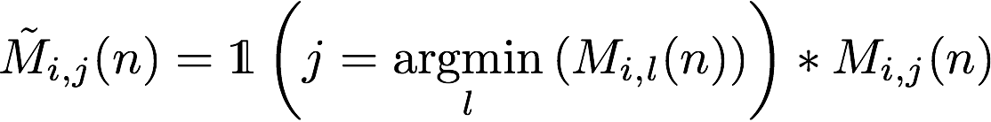
Proposed Prediction Error Extraction Method
Mean absolute error of each mapping stored as a matrix
Keep only the minimum value of each row in
Motion vector index
j^{th} Previous anchor frame

Slide 23
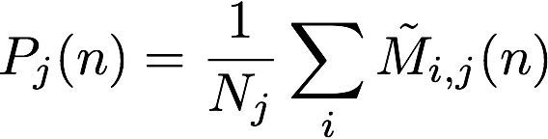
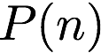
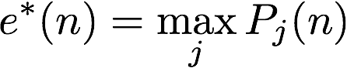
Proposed Prediction Error Extraction Method
Determine average error for each previous anchor frame
Report the maximum value of

Slide 24
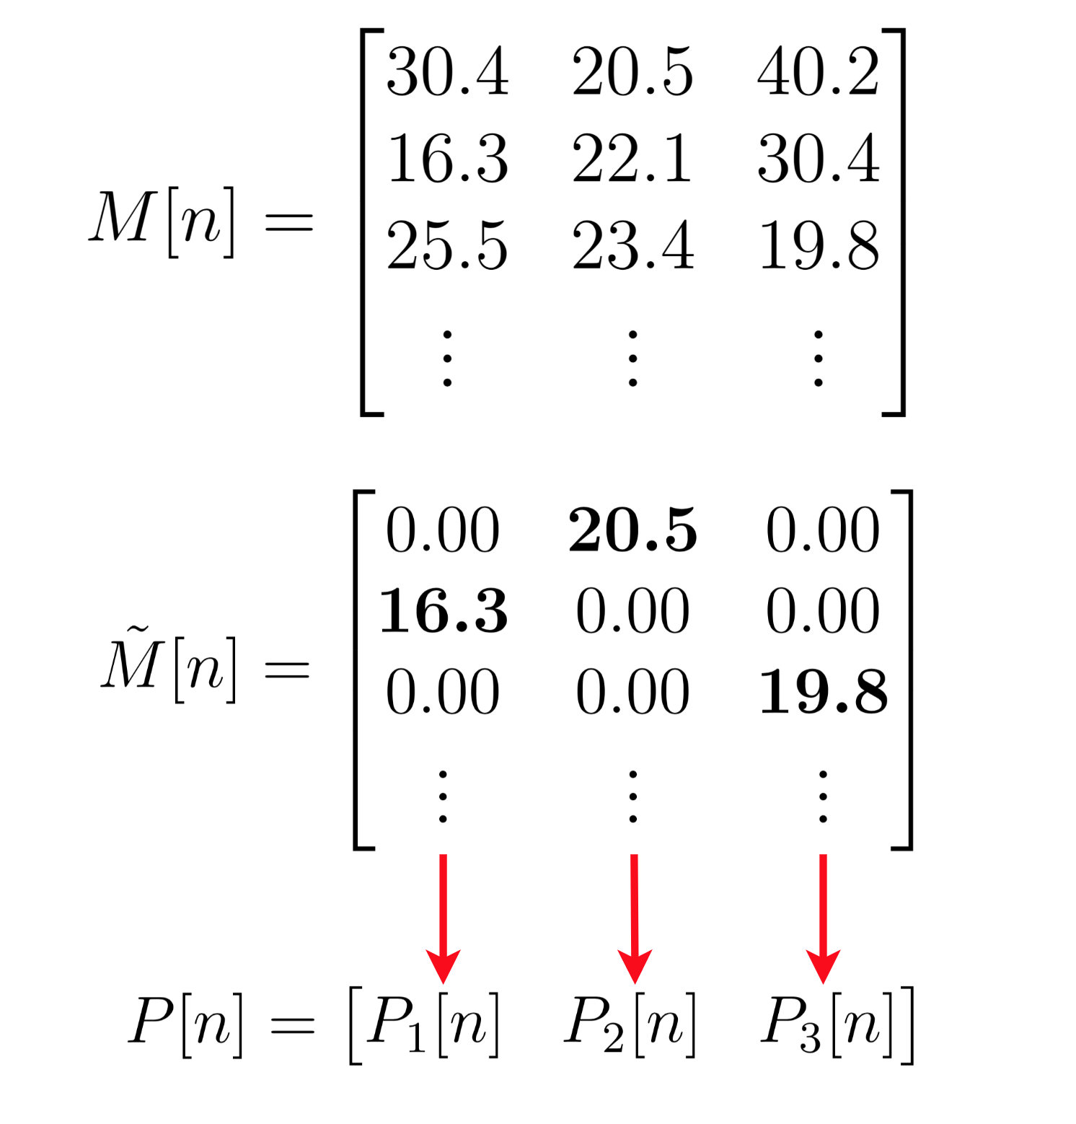
Proposed Prediction Error Extraction Method

Slide 25
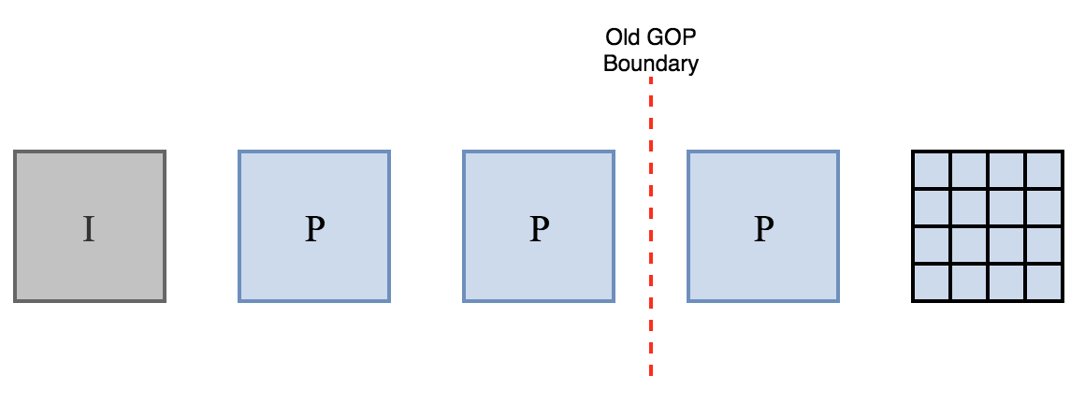
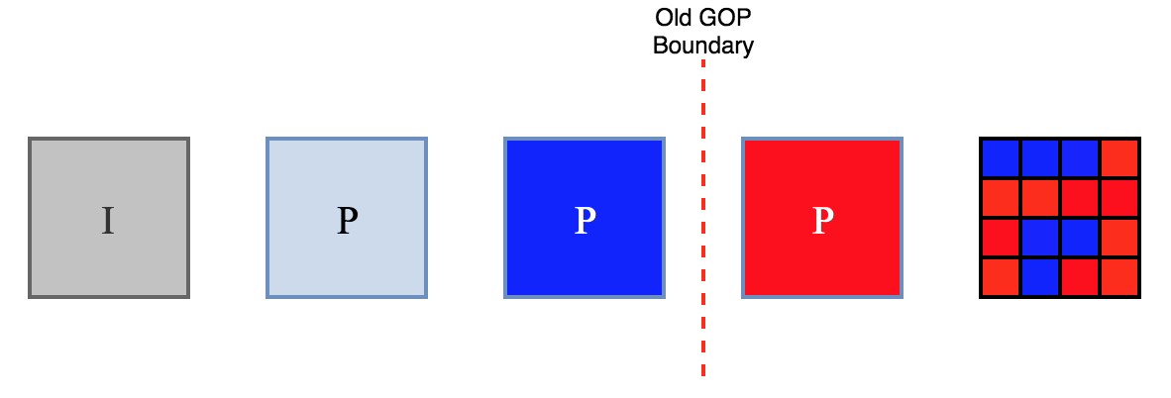
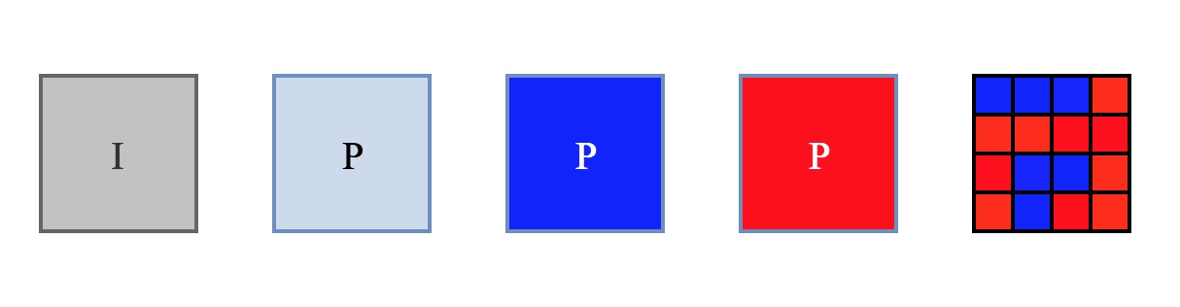
Proposed Prediction Error Extraction Method
Current Frame

Slide 26
New Detection Features

Slide 27
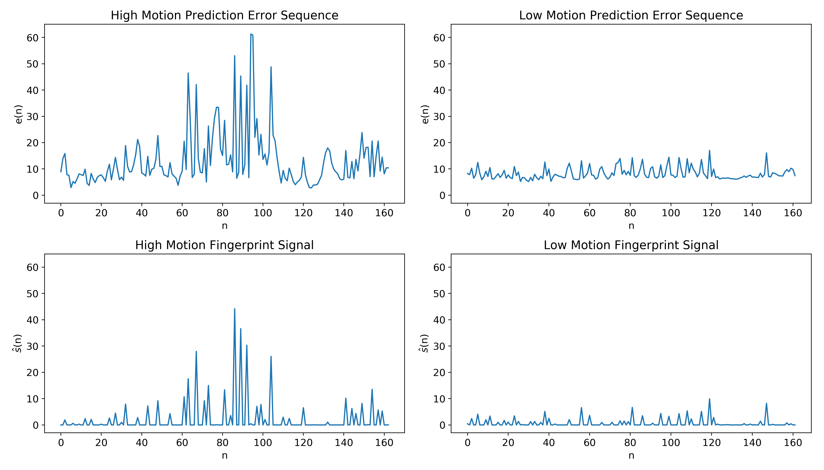
New Detection Features
Video capture conditions affect estimated fingerprint energy

Slide 28
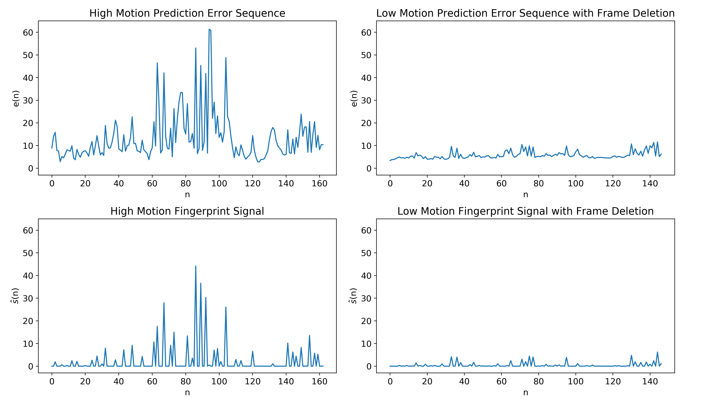
New Detection Features
To further illustrate

Slide 29
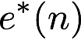
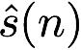
New Detection Features
Differences in capture conditions can result in misclassifications
Require some statistical representation of
The inferred prediction error sequence
The estimated fingerprint signal
Over the span of a few seconds, the sequences can be wide-sense stationary
We propose modeling the sequences as an autoregressive (AR) process

Slide 30
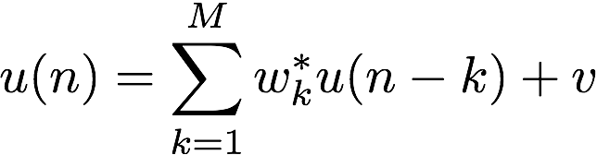
AR Models
Often used for forecasting
Predicts future values of the process using a linear combination of past observations and white noise
The variance of the noise term indicates the quality of the fit

Slide 31
New Detection Features
Construct AR model of both sequences
Add AR model parameters
Add Noise variance
In addition to the AR model parameters we add
The sample mean and variance of
The sample mean and variance of
These help scale the decision boundary

Slide 32
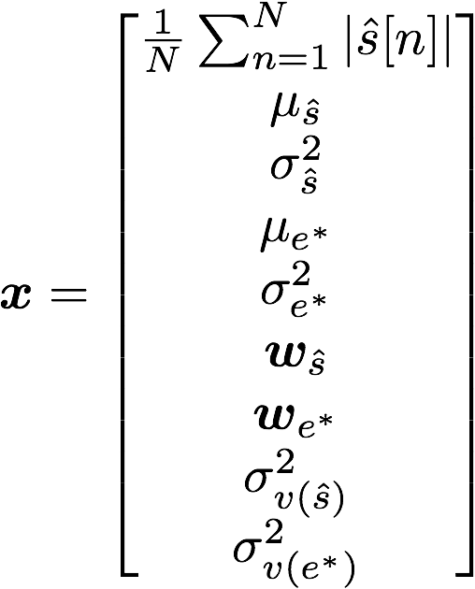
New Detection Features
Our final feature vector x is defined as

Slide 33
Proposed Classification Method

Slide 34
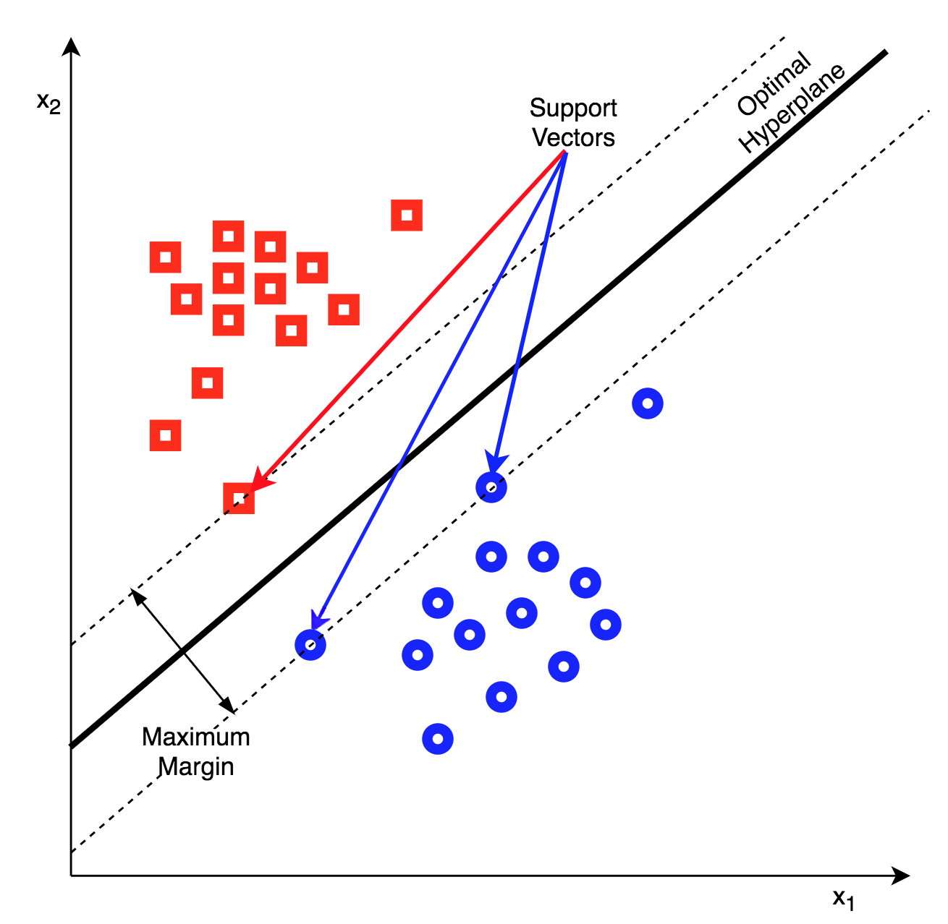
Proposed Classification Method
It is difficult to build parametric models of each feature
Want to make use of all features in aggregate
We propose using a Support Vector Machine (SVM) classifier

Slide 35
Experimental Results
We conducted a series of experiments to evaluate
The performance of our proposed prediction error extraction method
The performance of our enhanced feature set
We constructed a labeled dataset
The dataset was captured using seven camera models
Over 250 videos per camera model
~5 seconds long
Variety of lighting conditions (indoor & outdoor)
Variety of motion and scene content
Variety of GOP structures

Slide 36
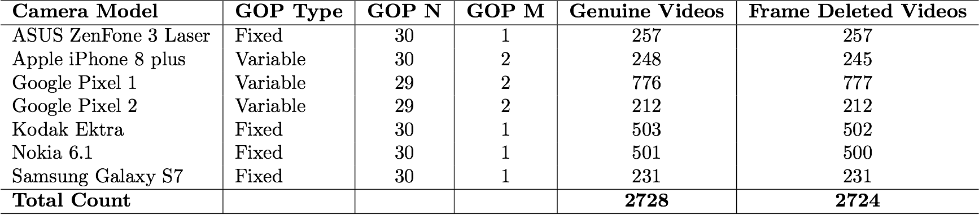
Dataset
Total of 5452 videos
Google Pixel 1 video captured from 3 devices
Kodak Ektra and Nokia 6.1 video captured from 2 devices

Slide 37
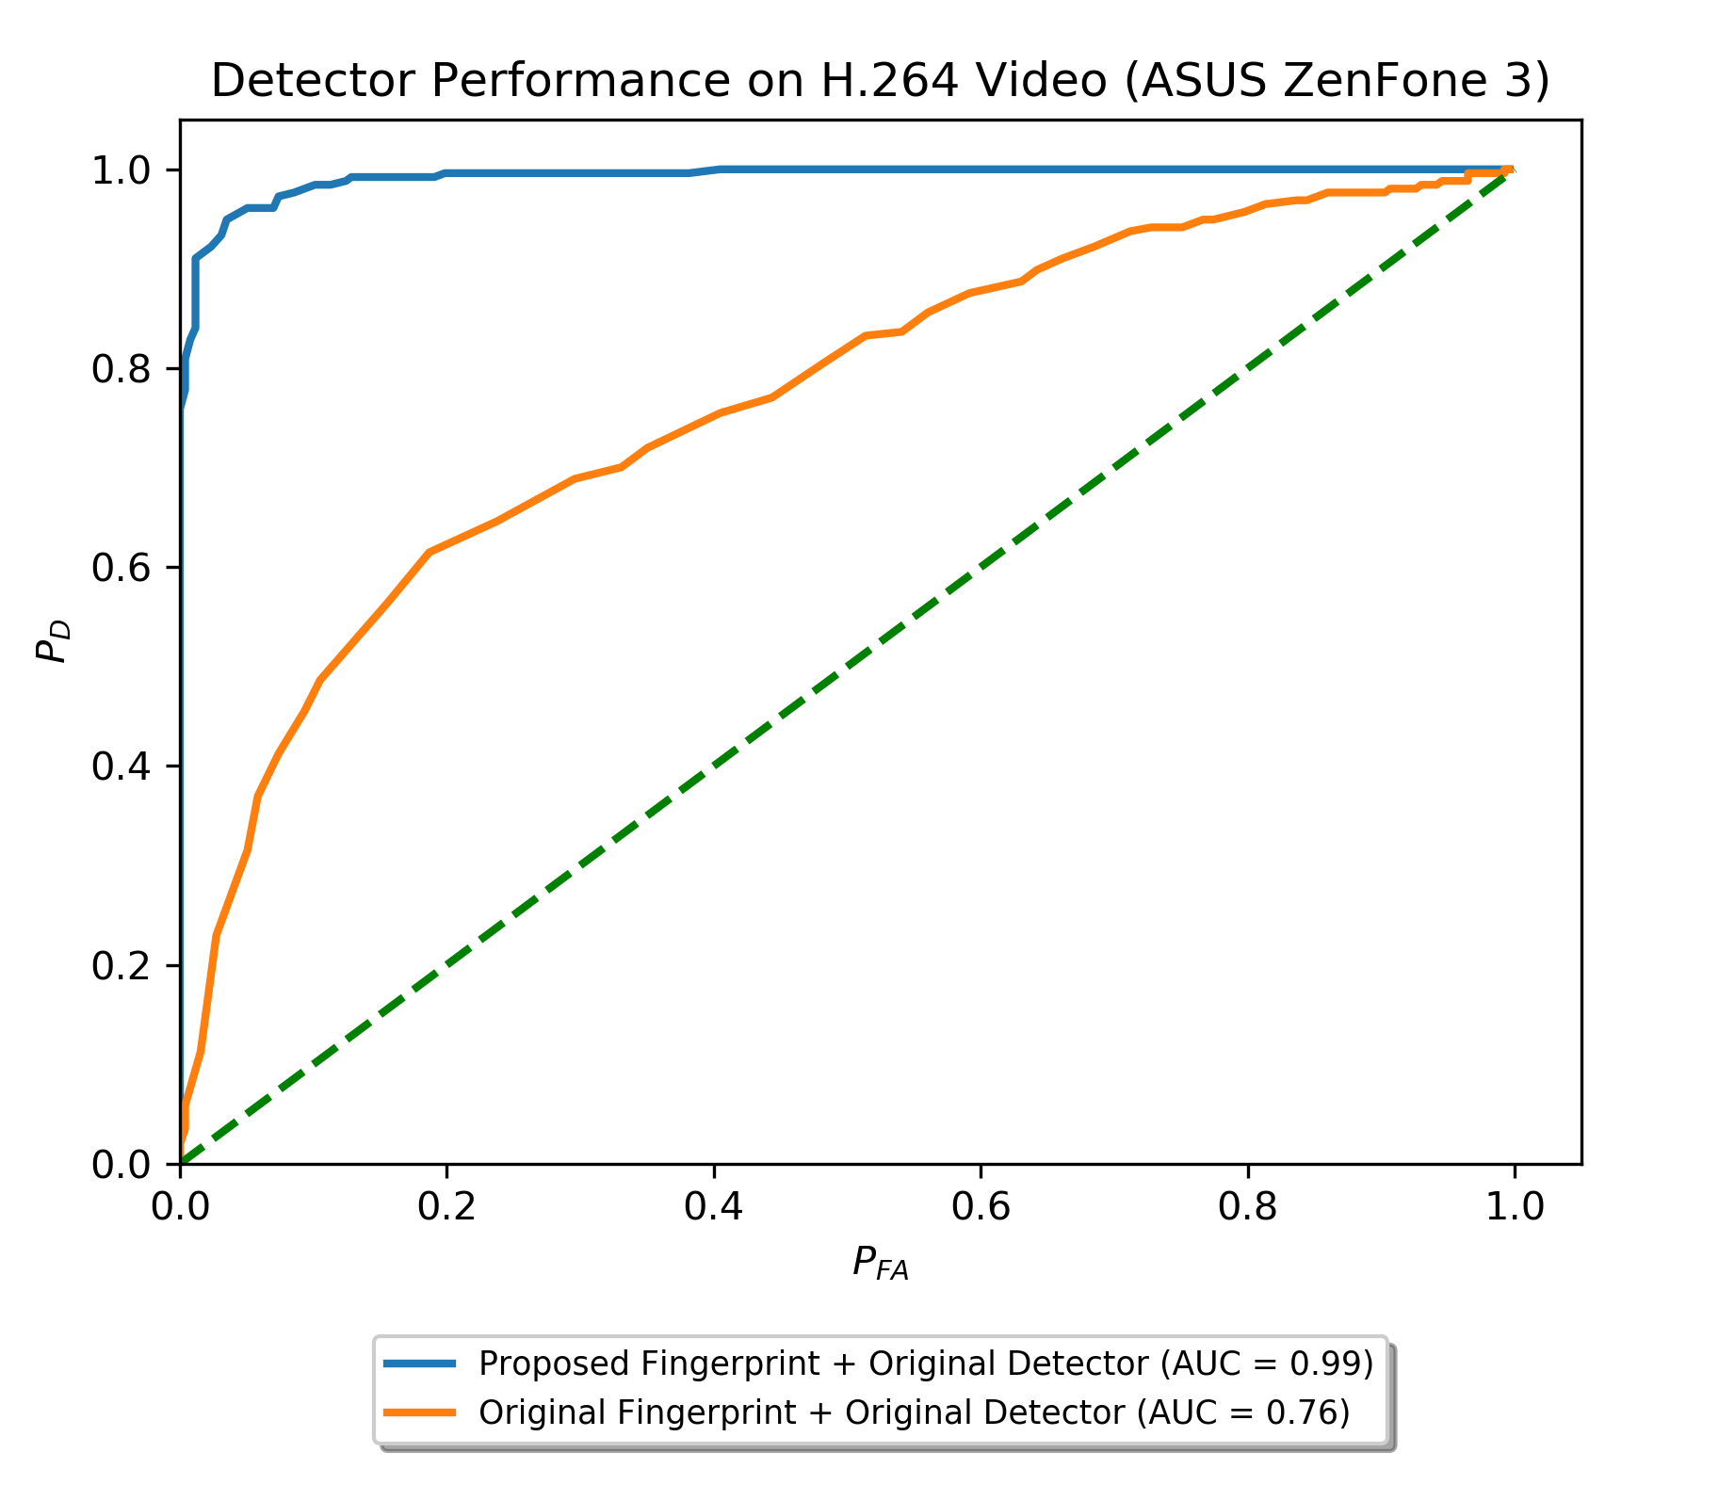
Experimental Results (One Camera)
Performance benchmarked using videos from one camera model (ASUS ZenFone 3 Laser)
Energy based detector
Proposed Extraction Method
AUC of 0.99 (v.s. 0.76)
P_{D} of 0.9 at 5% P_{FA} (v.s. 0.4)

Slide 38
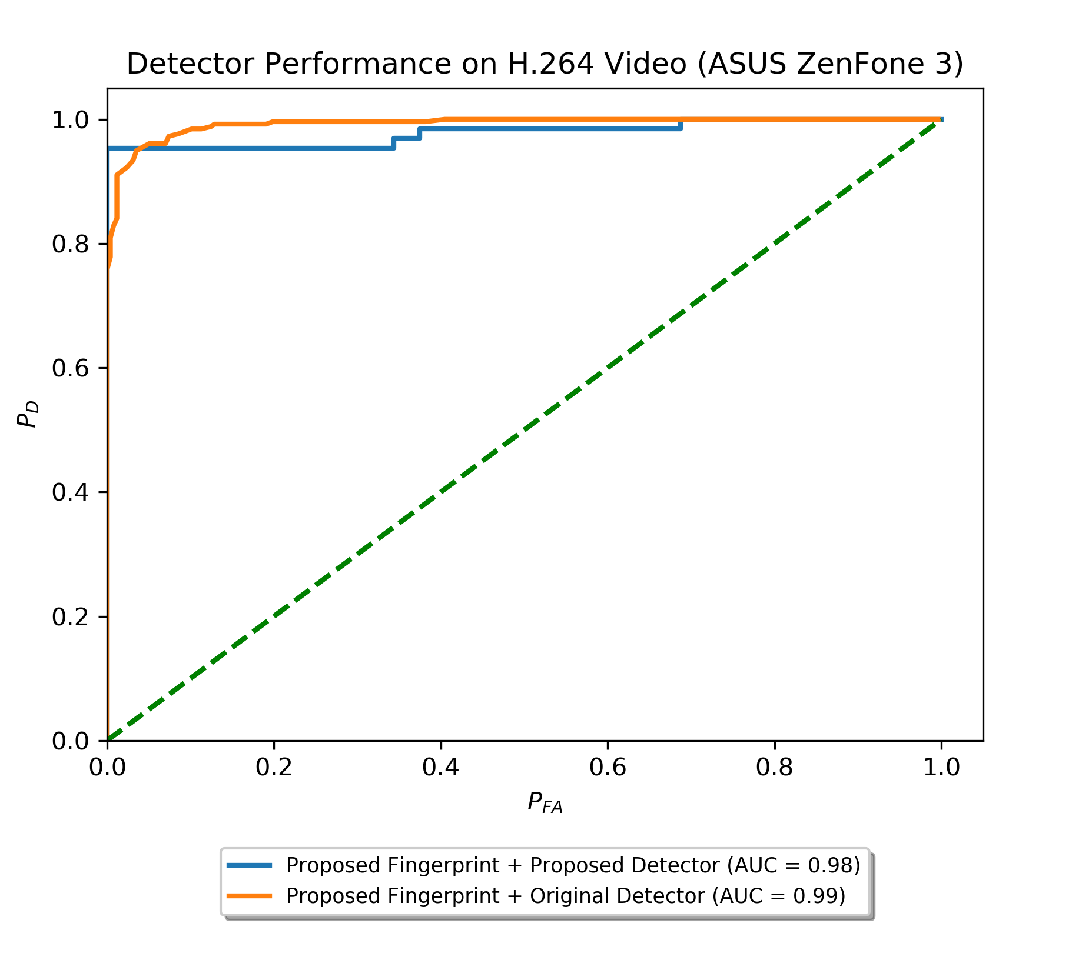
Experimental Results (One Camera)
SVM trained using videos from one camera model
75-25 Train-test split
Radial Basis Kernel
AR Model order of 31
Effects of Proposed Detector
P_{D} of 0.95 at 1% P_{FA} (v.s. 0.8)

Slide 39
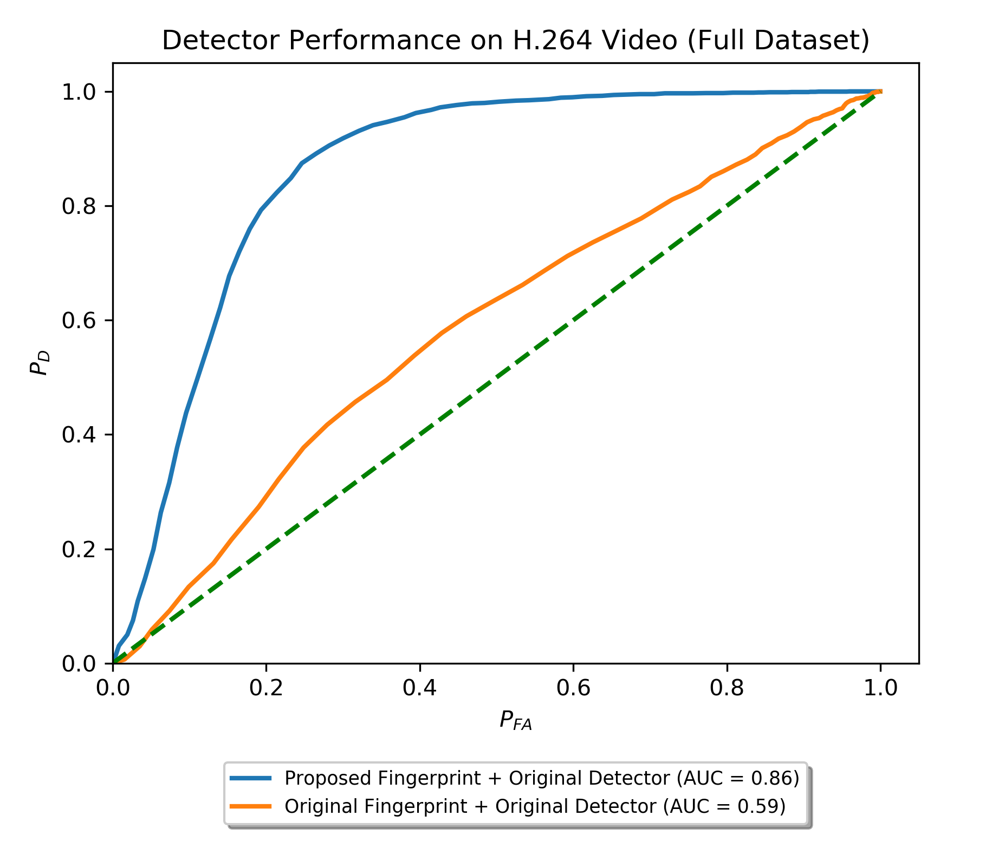
Experimental Results (All Cameras)
Performance of detector evaluated using videos from all camera models
Energy Based detector
Proposed Extraction Method
AUC of 0.86 (v.s. 0.59)
P_{D} of 0.5 at 10% P_{FA} (v.s. 0.15)

Slide 40
Experimental Results (All Cameras)
Evaluate performance of proposed detector on all videos
Extract prediction error using both original & proposed methods
Generate feature vectors
SVM trained using videos from all camera models
75-25 Train-test split
Radial Basis Kernel
AR Model order of 31

Slide 41
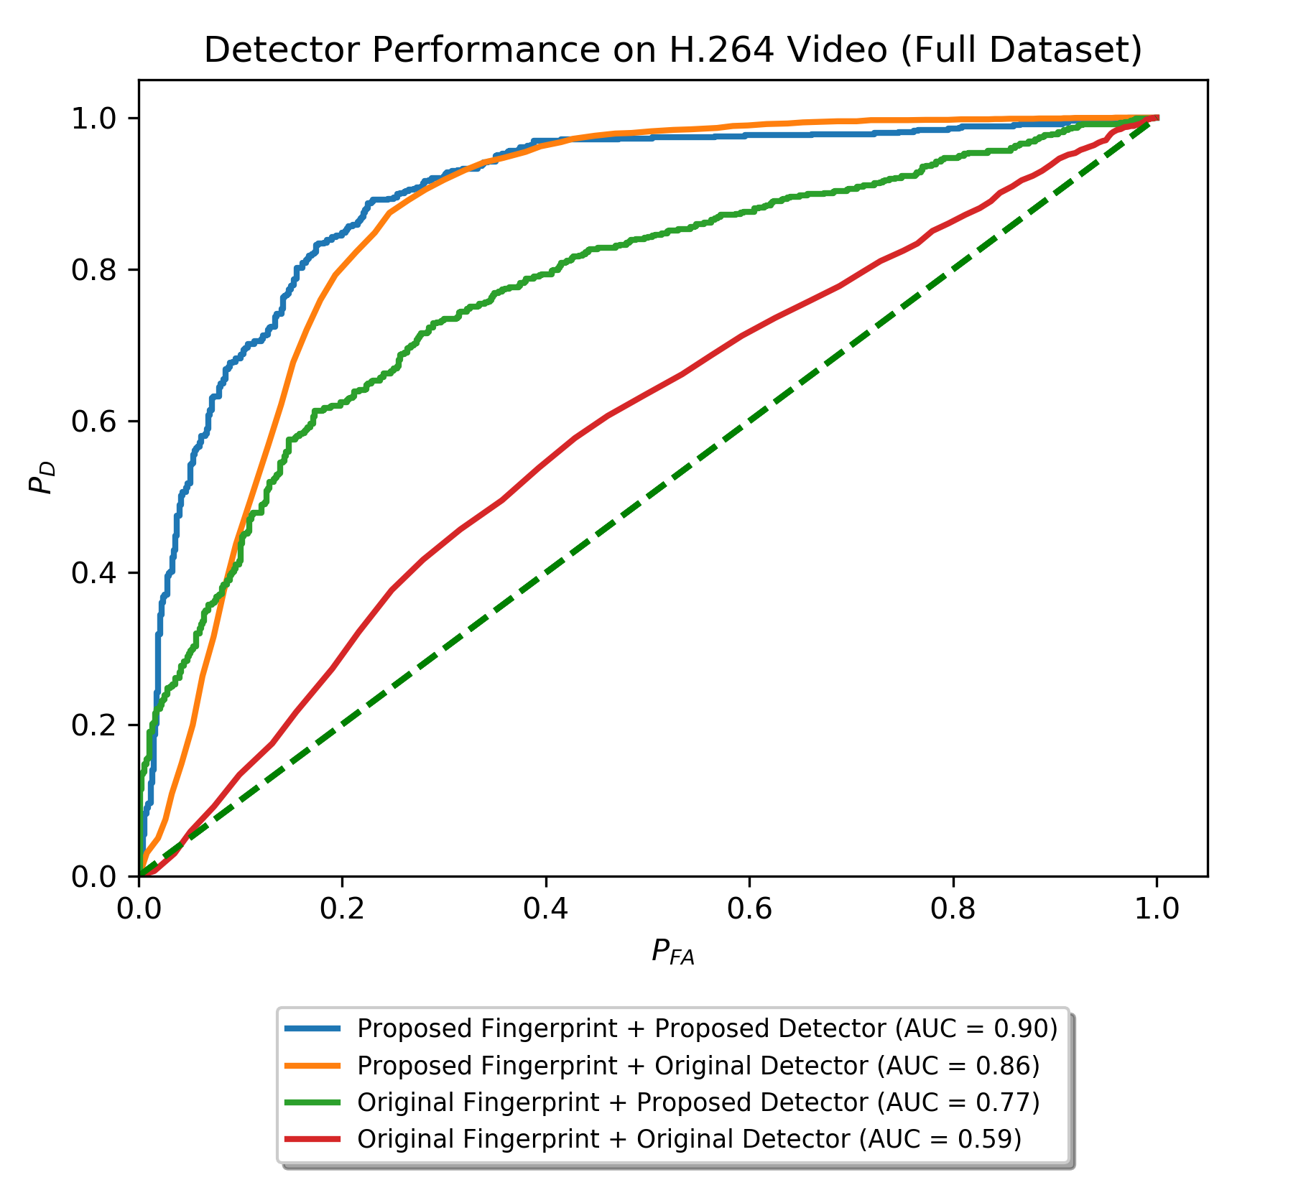
Experimental Results (All Cameras)

Slide 42
Experimental Results (Summary)
Original fingerprint + detector fail on diverse dataset
Both proposed fingerprint & detector increase performance
Proposed fingerprint + detector yield best performance
AUC of 0.9 (v.s. 0.59)
P_{D} of 0.6 at 5% P_{FA} (v.s. 0.05)

Slide 43
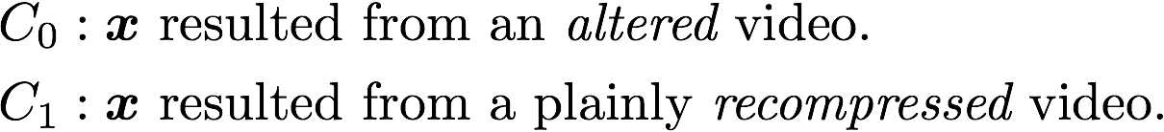
Limitations
Detector considered under limited scenario
Plainly recompressed videos can exhibit similar fingerprints
Given a feature vector x was found to have frame deletion

Slide 44
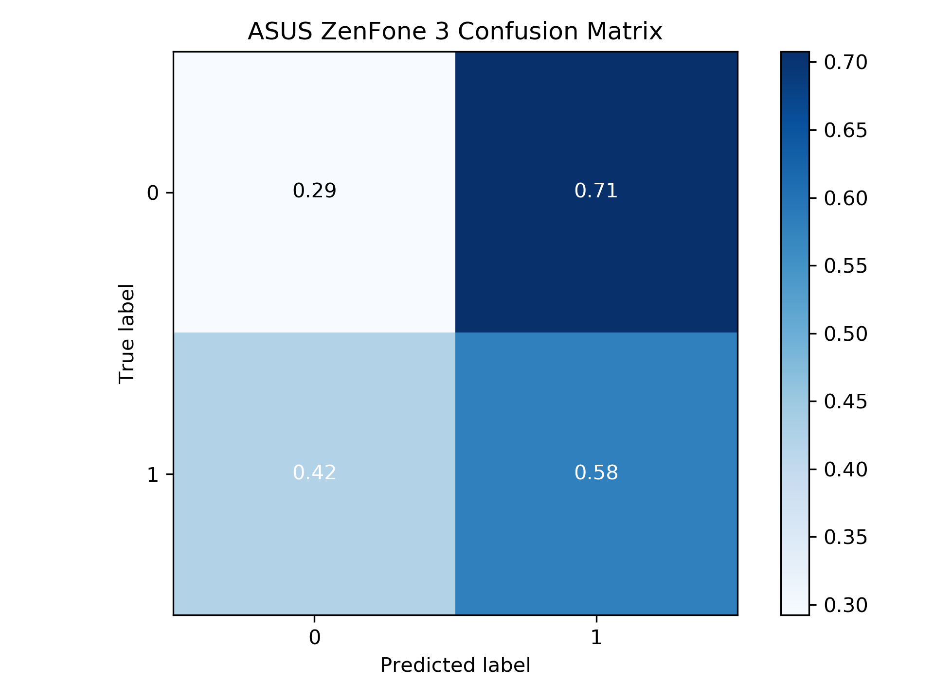
Limitations
Additional 257 plainly recompressed videos created
Using ASUS ZenFone 3
Used Proposed fingerprint + detector
Plotted confusion matrix
Altered videos confused for recompressed videos

Slide 45
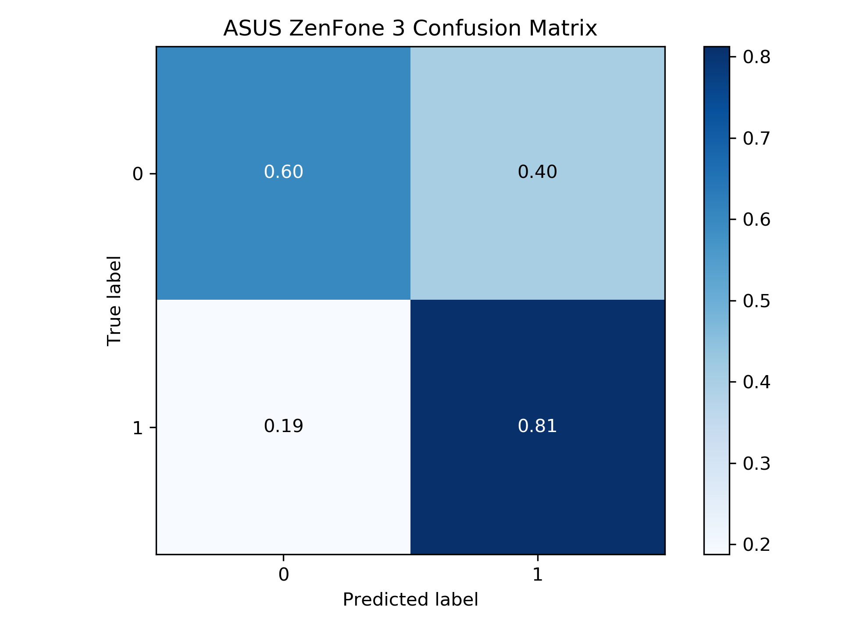
Limitations
Can alter system to improve accuracy
Input observations scaled
Zero mean
Unit Variance
Frame deletion features can provide some differentiation
Incorporating additional solutions is future work

Slide 46
Conclusion
Original frame deletion fingerprints not expressed in H.264 video
Proposed new methodology for H.264
New fingerprint extraction technique
New Classification Framework
Evaluated new methods
ROC area increased by 0.31
P_{D} increased by 0.55 at 5% P_{FA}
Noted system limitations, potential solutions, future work

Slide 47
A New Approach to Detecting Frame Deletion in H.264 Encoded Digital Video
Hunter Kippen
Advisor: Dr. Matthew Stamm
Drexel University
hmk64@drexel.edu

